Slide 1
CAR BLACK BOX

Slide 2
INTRODUCTION
Nowadays the rate of road accidents is increasing day-by-day. This problem is increasing due to poor riding behavior such as high speed, drunken driving, riding without safety etc.,.
Our project is to monitor the final moment of impact of accident and stores to a memory.
When the car crashes the system send the accident alert to a preprogrammed mobile number via GSM Modem.

Slide 3
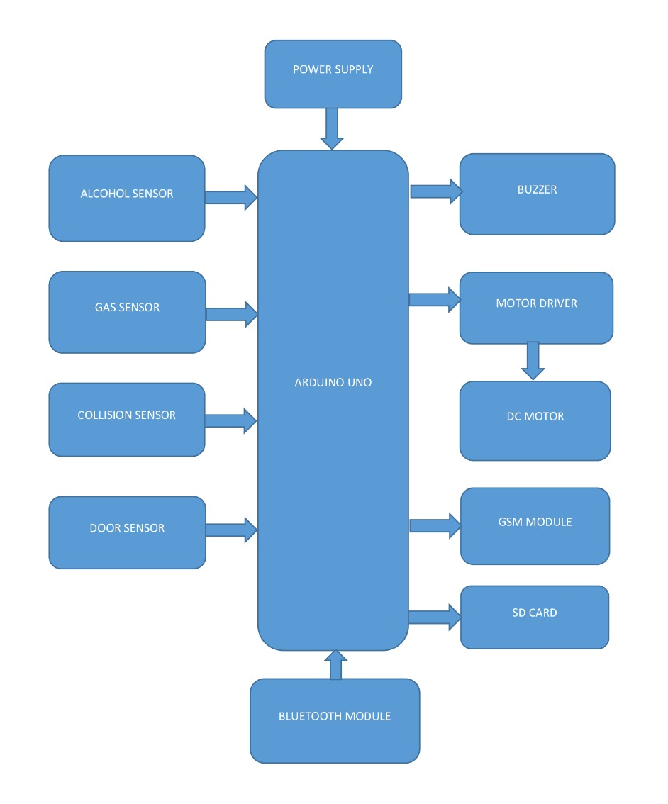
BLOCK DIAGRAM

Slide 4
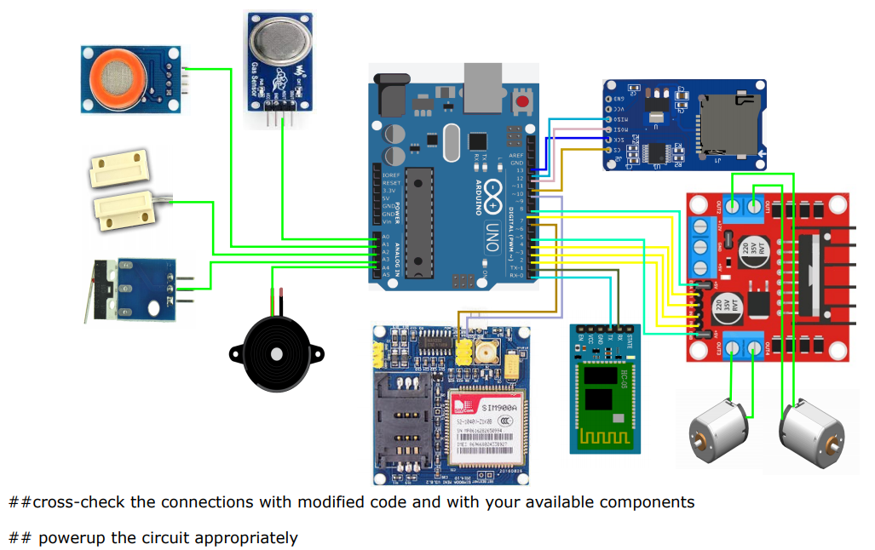
CIRCUIT DIAGRAM

Slide 5
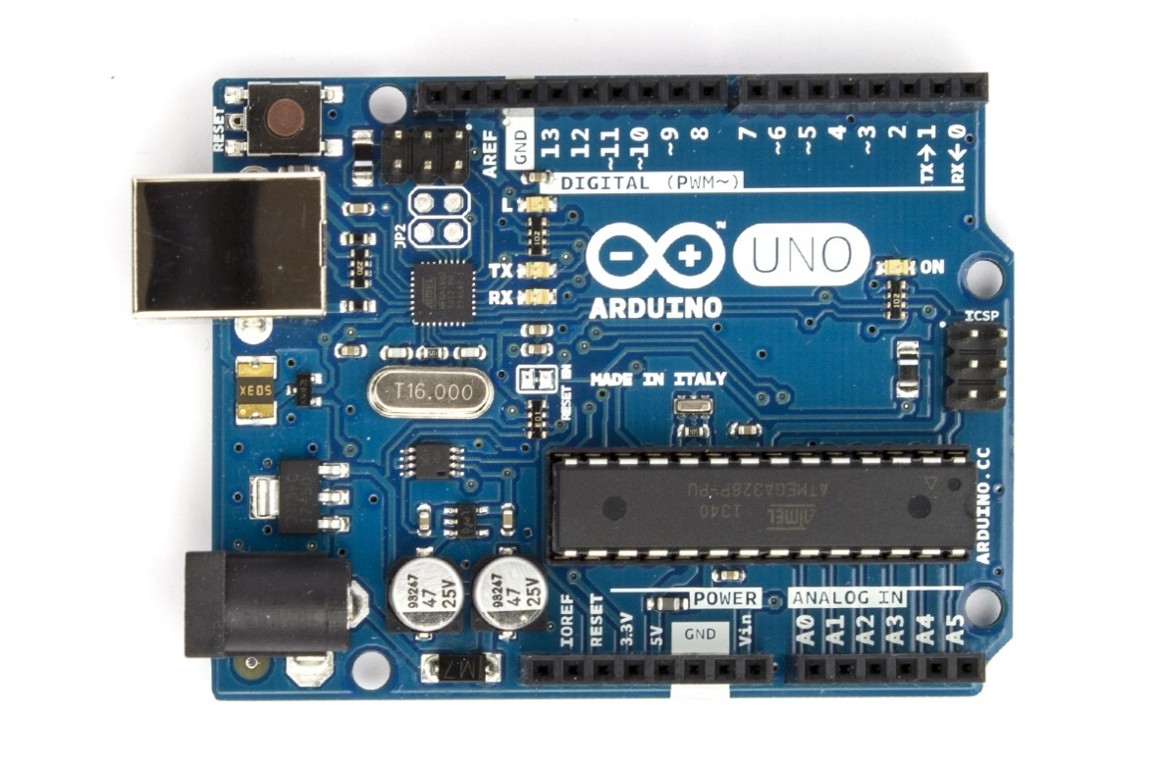
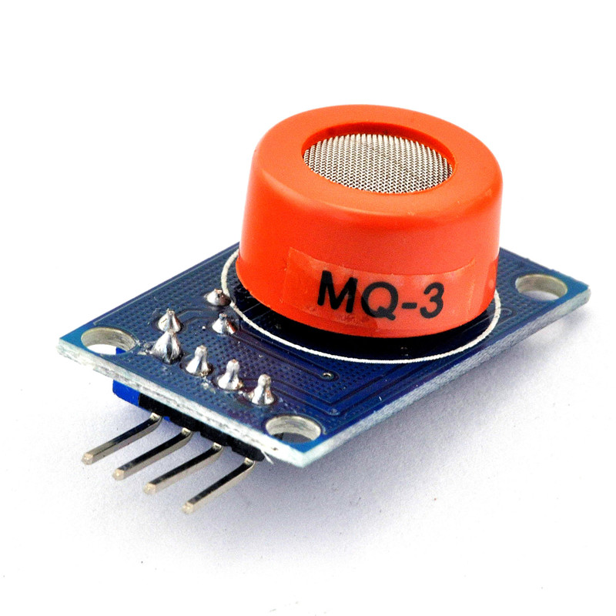
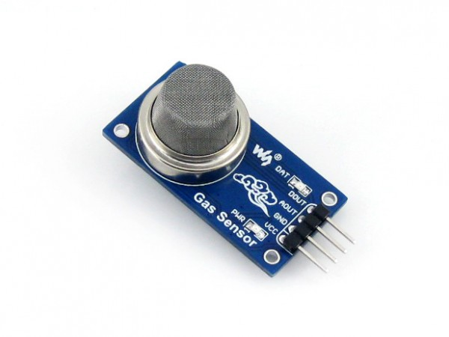
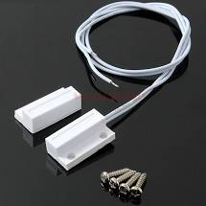
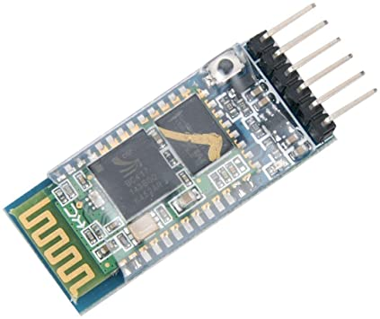
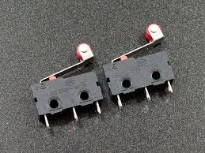
Components used
MQ-2 Gas Sensor
Arduino Uno
MQ-3 Alcohol Sensor
Door sensor
Collision Sensor (SPDT)
Bluetooth Module

Slide 6
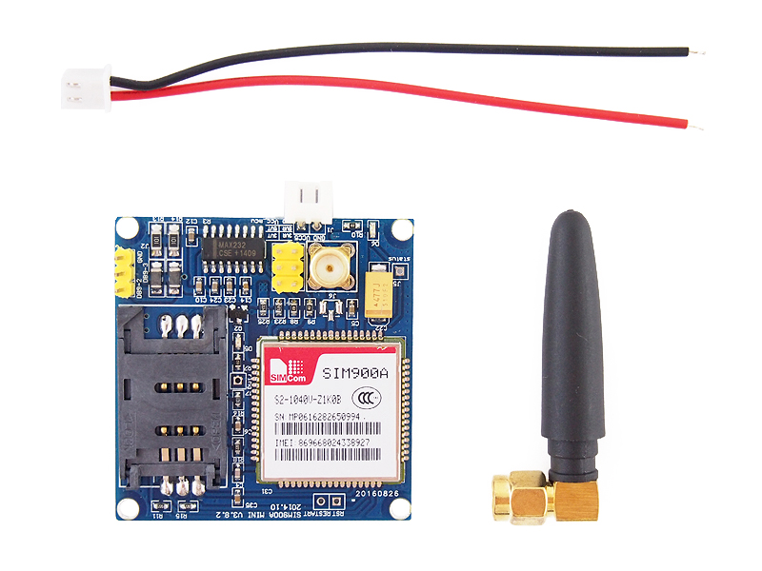
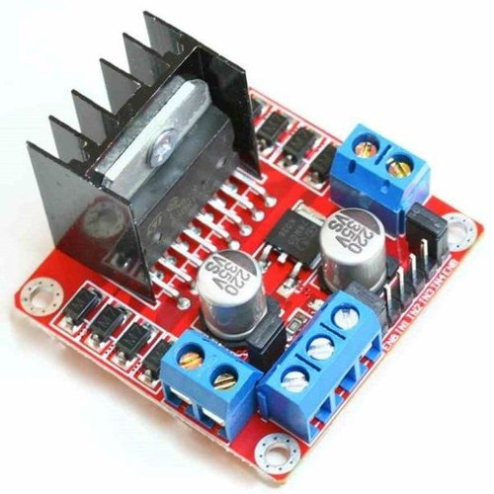
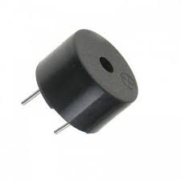
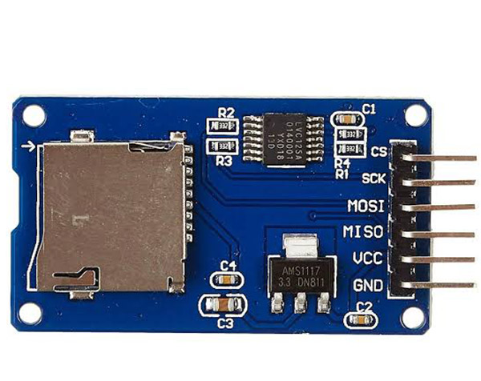
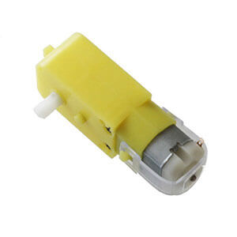
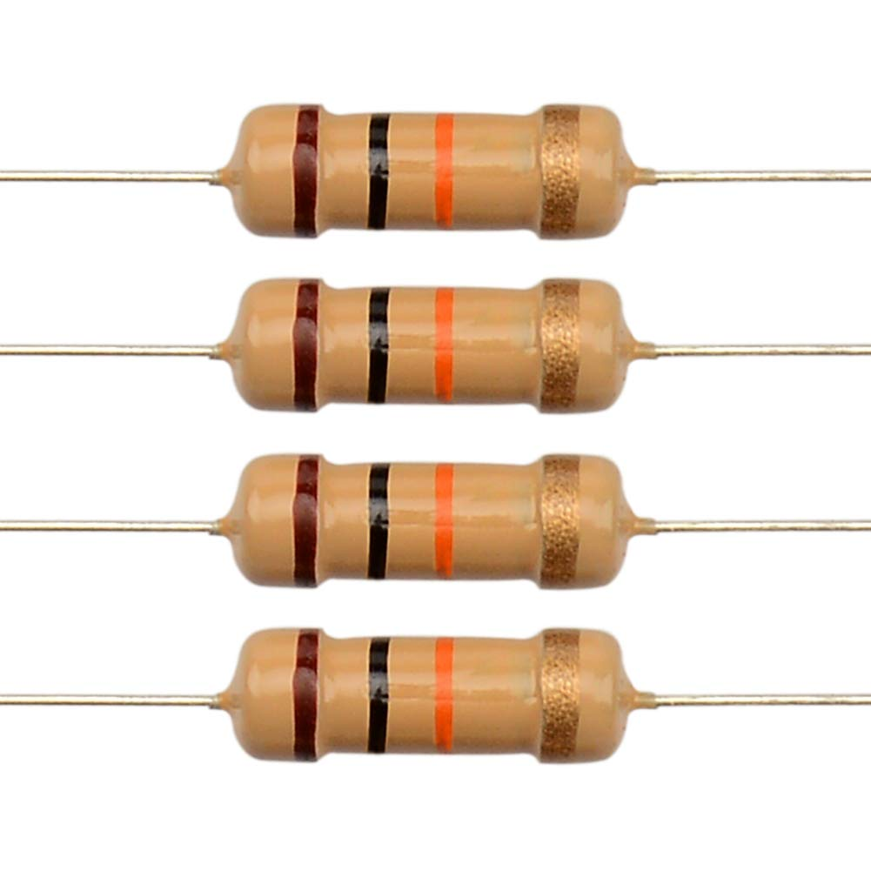
Buzzer
GSM Module
L298 Motor Driver
10k Resistor
BO Motor
SD card module

Slide 7
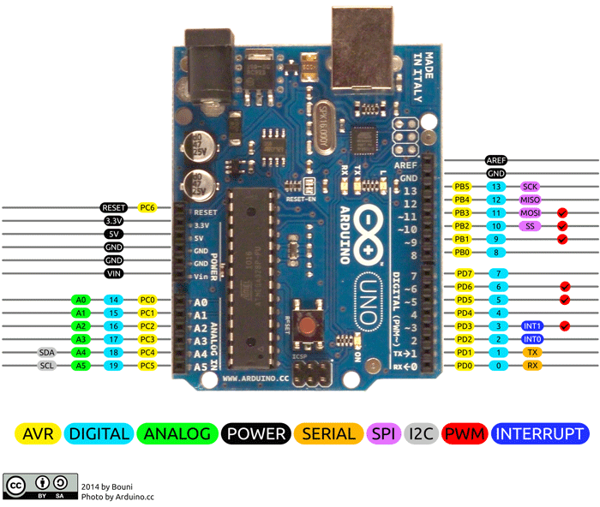
Arduino UNO
The Arduino Uno is an open source microcontroller board based on the microchip ATmega328P microcontroller.
The board is equipped with sets of digital and analog input/output (I/O) pins that may be interfaced to various expansion boards and other circuits.
The board has 14 digital I/O pins (six capable of PWM output),6 analog I/O pins, and is programmable with the Arduino IDE (Integrated Development Environment), via a type B USB cable.

Slide 8
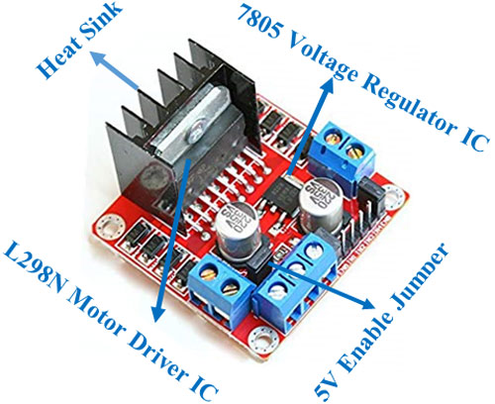
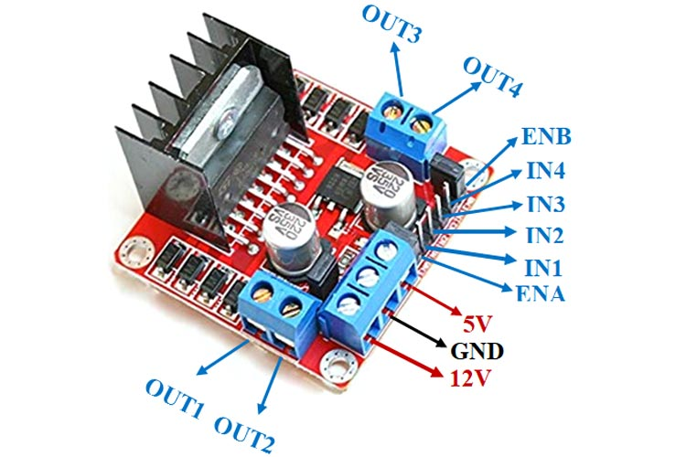
L298 Motor Driver
This L298N Motor Driver Module is a high-power motor driver module for driving DC and Stepper Motors.
This module consists of an L298 motor driver IC and a 78M05 5V regulator.
L298N Module can control up to 4 DC motors, or 2 DC motors with directional and speed control.

Slide 9
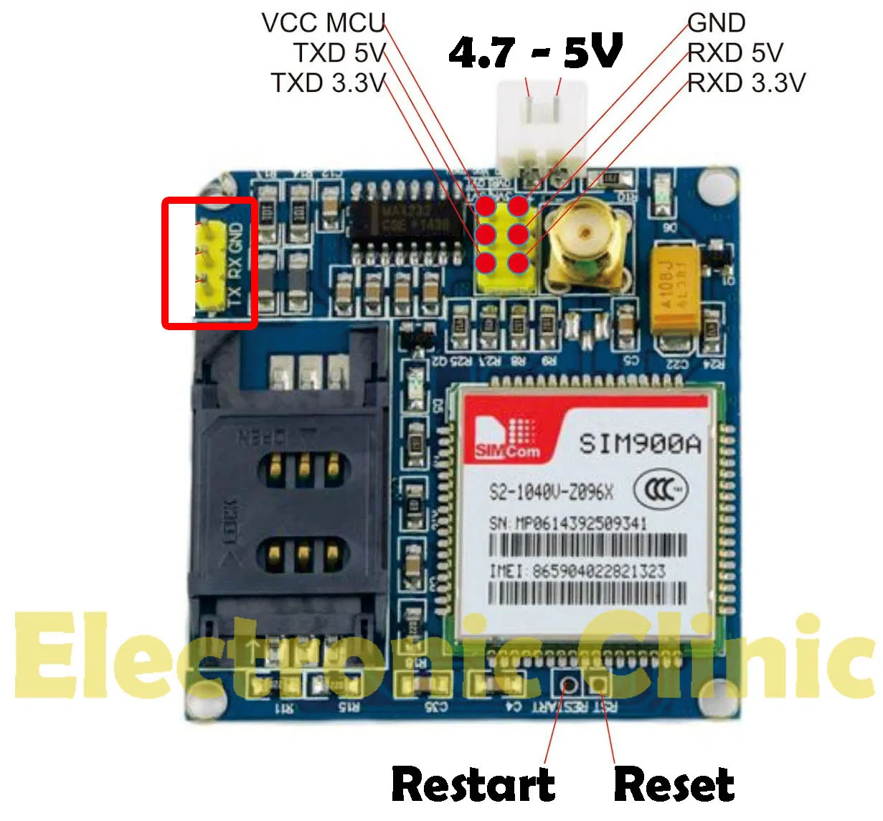
SIM 900A GSM Module
The SIM900A is a readily available GSM/GPRS module used in many mobile phones and PDA.
SIM900A is a dual-band GSM/GPRS engine that works on frequencies EGSM 900MHz and DCS 1800MHz.
It supports single SIM card of 2G.
The communication with this module is done through UART or RS232 Interface. The data is sent to the module or received from the module though UART interface.

Slide 10
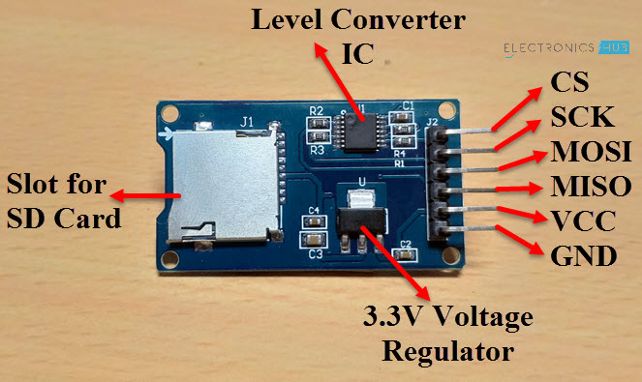
SD card Module
An SD Card Module or a Micro SD Card Adapter is a simple board which facilitates connection between a Micro SD card and a Microcontroller.
Since Arduino operates at 5V and the Micro SD Card operates at 3.3V, an SD Card Module basically consists of two important components.
They are the 3.3V Voltage Regulator IC and a 5V to 3.3V Level Converter IC for the communication pins.

Slide 11
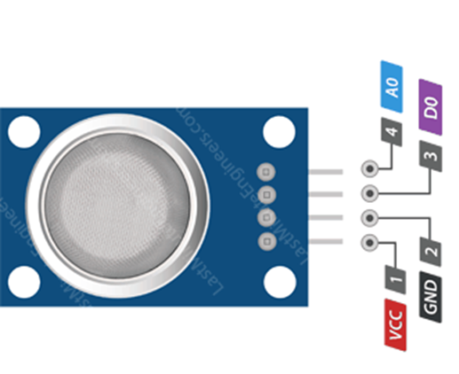
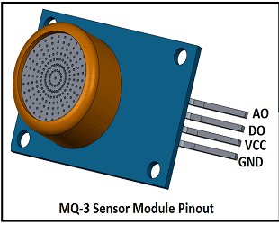
MQ-2 Sensor(Gas)
MQ-3 Sensor(Alcohol)
An alcohol sensor detects the attentiveness of alcohol gas in the air and an analog voltage is an output reading.
The sensor can activate at temperatures ranging from -10 to 50° C with a power supply is less than 150 Ma to 5V.
MQ-2-Methane, Butane, LPG, Smoke
MQ2 gas sensor is an electronic sensor used for sensing the concentration of gases in the air such as LPG, propane, methane, hydrogen, alcohol, smoke and carbon monoxide.

Slide 12
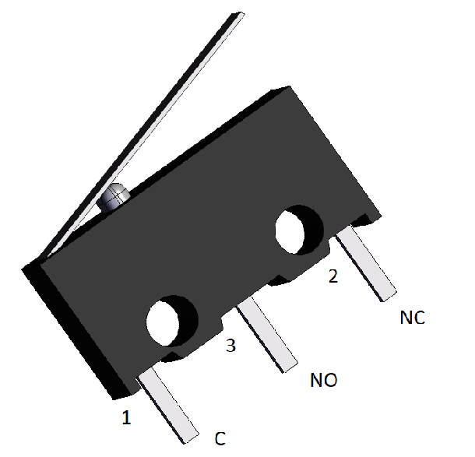
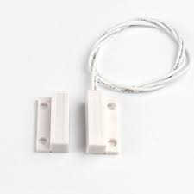
Magnetic Switch
Collision Sensor
MC-38 Wired Door Window Sensor Magnetic Switch can be used as a door or window security system. It produces the signal when moved away from each other which can be fed to the micro-controller to perform the desired action as per requirement.
This wired sensor is trigger by the magnet. When the magnet is closed by, the circuit is closed or open if the magnet far from the sensor.
It is used to detect the collision and sent back a signal to microcontroller.
There are three pins: C,NO,NC. C for controlling, NO stands for normally open, NC stands for Normally closed.

Slide 13
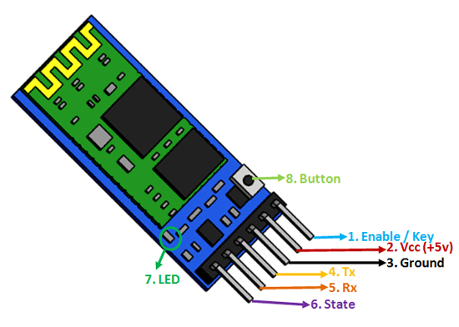
Bluetooth module
The HC-05 is a very cool module which can add two-way wireless functionality. This module to communicate between two microcontrollers like Arduino or communicate with any device with Bluetooth functionality like a Phone or Laptop.
The module communicates with the help of USART at 9600 baud rate hence it is easy to interface with any microcontroller that supports USART
The HC-05 has two operating modes, one is the Data mode in which it can send and receive data from other Bluetooth devices and the other is the AT Command mode where the default device settings can be changed.

Slide 14
DESIGN PROCEDURE
Step 1: Initialization of SD Card
The SD card is detected. If the card is initialized, the SD card will be ready to write the data at the time of collision.
Step 2: Checking the door and the alcohol content
Check the door is closed through magnetic switch. If it is open, buzzing sound is produced. If it is closed, the car will move.
Similarly, the alcohol content will be checked through MQ-3 sensor. If the value is higher than 700, the alcohol content is present then car will not move. If the value is less than 700, the car will move.

Slide 15
Step 3: Regular check of CO2 level
The CO2 level is regularly checked through MQ-2 sensor and note down the level.
Step 4: Connecting Bluetooth for movement
By using Bluetooth module, the car is connected with mobile via ‘Bluetooth RC Controller’ and sent the signal for the movement in different directions.

Slide 16
Step 5: Collision detected
If collision occurs, send an alert of accident to the preprogrammed mobile number via GSM Modem.
The data from various sensors such as CO2 sensor, alcohol sensor will be written to the SD card at the time of occurrence.

Slide 17
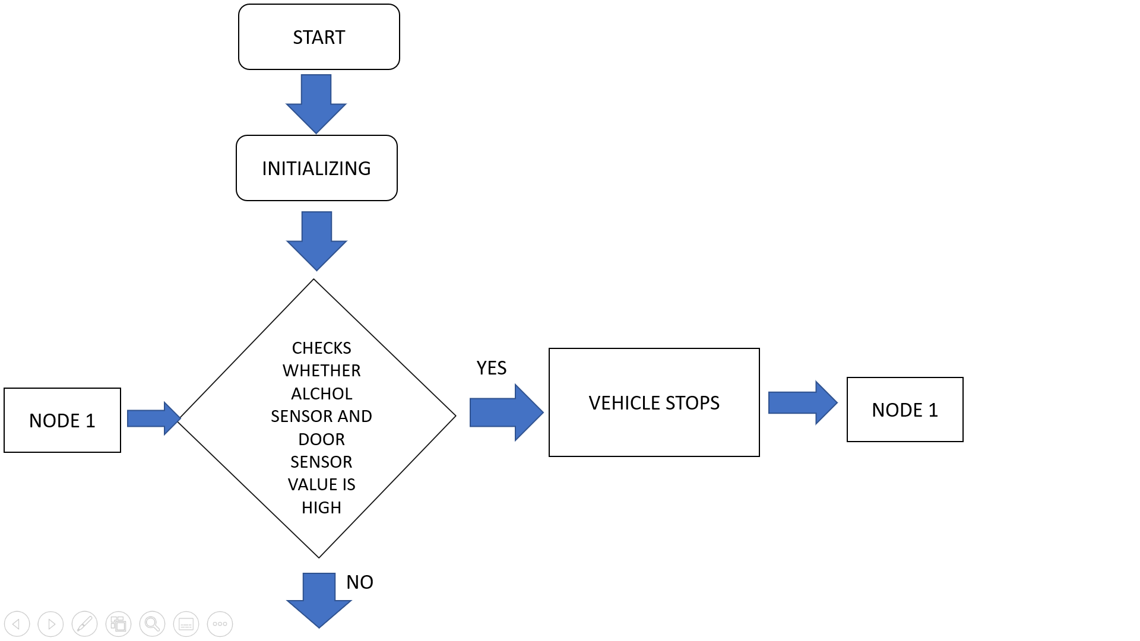
FLOWCHART

Slide 18
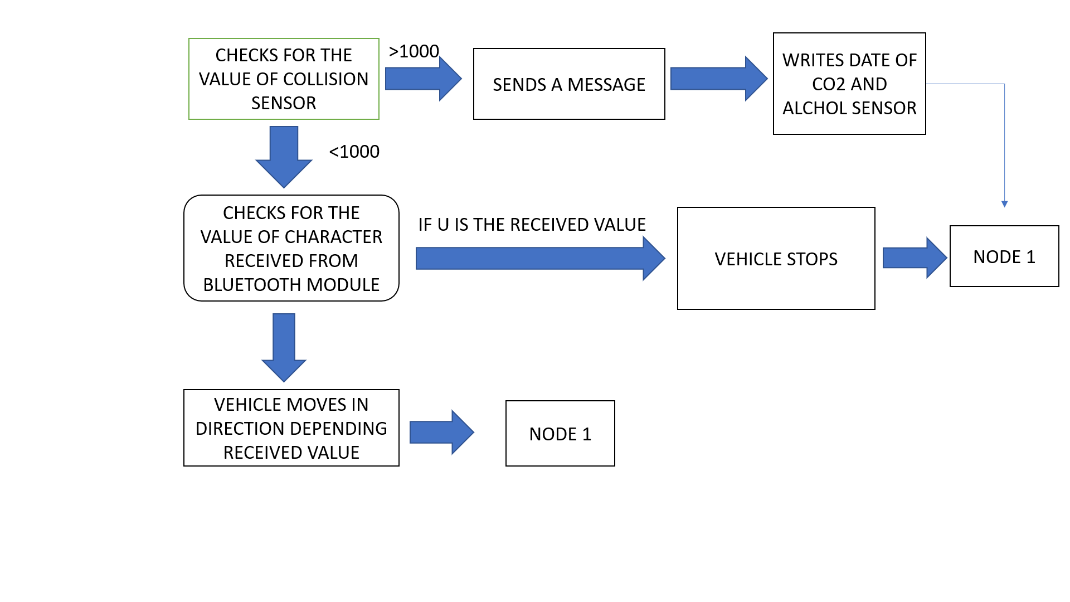

Slide 19
ADVANTAGES
It is inexpensive.
Once it is installed in a car, it will continue to monitor the driving behaviors of the driver which may be difficult to observe by any other means.
In case of an accident, it gives more objective, accurate and detailed information a few minutes before the incident.
It is the best tool for employers to monitor and assess their drivers.
It is a vital tool for improving safety and reducing risk and crash rates.
It is a way to help young and new drivers to improve their driving behaviors.
It also helps insurance companies to reduce traffic accidents by promoting safe driving through black box insurance.
It can provide data that can help the road safety or highway authorities to easily identify problem locations on their road network.

Slide 20
DISADVANTAGES
Since high current is used to drive components, we introduced an adapter instead of battery.
It cannot prevent dangers, it can only record the data at the time of occurrence.
If the accident occurs in a remote area with network issues, the message cannot be sent to preprogrammed mobile number.

Slide 21
Future Scope
GPS system can be introduced to find the exact location of the incident.
The case protection to the sensors can also be given to protect them from crash.
The face detection detects if the driver is awake or not while he was driving. This helps to prevent occurring of accident due to carelessness.
By introducing camera module and voice recorder, both video and audio can be recorded and stored in SD card.
By integrating ABS sensor, the condition of braking system can be analysed.

Slide 22
Thank You

